Slide 1
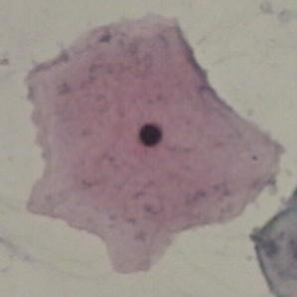
NORMAL CELLS :
TYPES OF CELLS
SUPERFICIAL SQUAMOUS CELL
CELL SIZE : Large
CELL SHAPE : Flat / Oval
NUCLEUS : Very small
CYTOPLASM : Bright , Sharply demarcated ,Stains Red

Slide 2
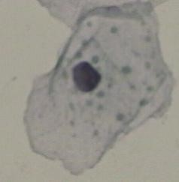
INTERMEDIATE SQUAMOUS CELL
CELL SIZE : Large
CELL SHAPE : Round
NUCLEUS : Large
CYTOPLASM : Light blue/Blue-Green

Slide 3
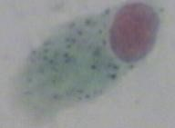
COLUMNAR EPITHELIAL CELLS
CELL SIZE : Large
CELL SHAPE : Column Like
NUCLEUS : Large
CYTOPLASM : Distributed Chromatin, Stain more Dark Blue

Slide 4
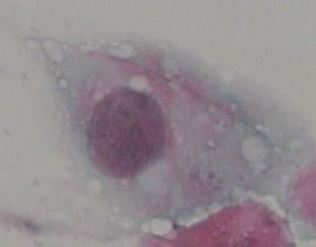
ABNORMAL CELLS :
MILD DYSPLASIA
CELL SIZE : Very Large
NUCLEUS : Large/Light
CYTOPLASM : Light, Generous and See-through
N/C RATIO : Medium

Slide 5
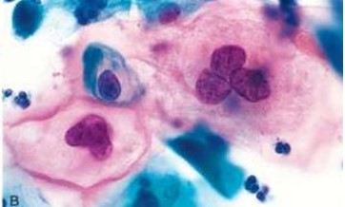
MORDARATE DYSPLASIA
CELL SIZE : Very Large
NUCLEUS : Large/Dark
CYTOPLASM :Dark
N/C RATIO : Large

Slide 6
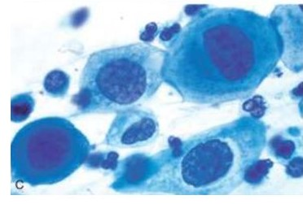
SERVER DYSPLASIA
CELL SIZE : Very Large
NUCLEUS : Large/Dark/Deform
CYTOPLASM :Dark
N/C RATIO : Very Large

Slide 7

CARCINOMA IN SITU
CELL SIZE : Large
CYTOPLASM : Sparse and Basophilic
NUCLEUS : about 3-5 times large than normal nuclei
N/C RATIO : Very Large

